Slide 1
8051 Addressing mode

Slide 2
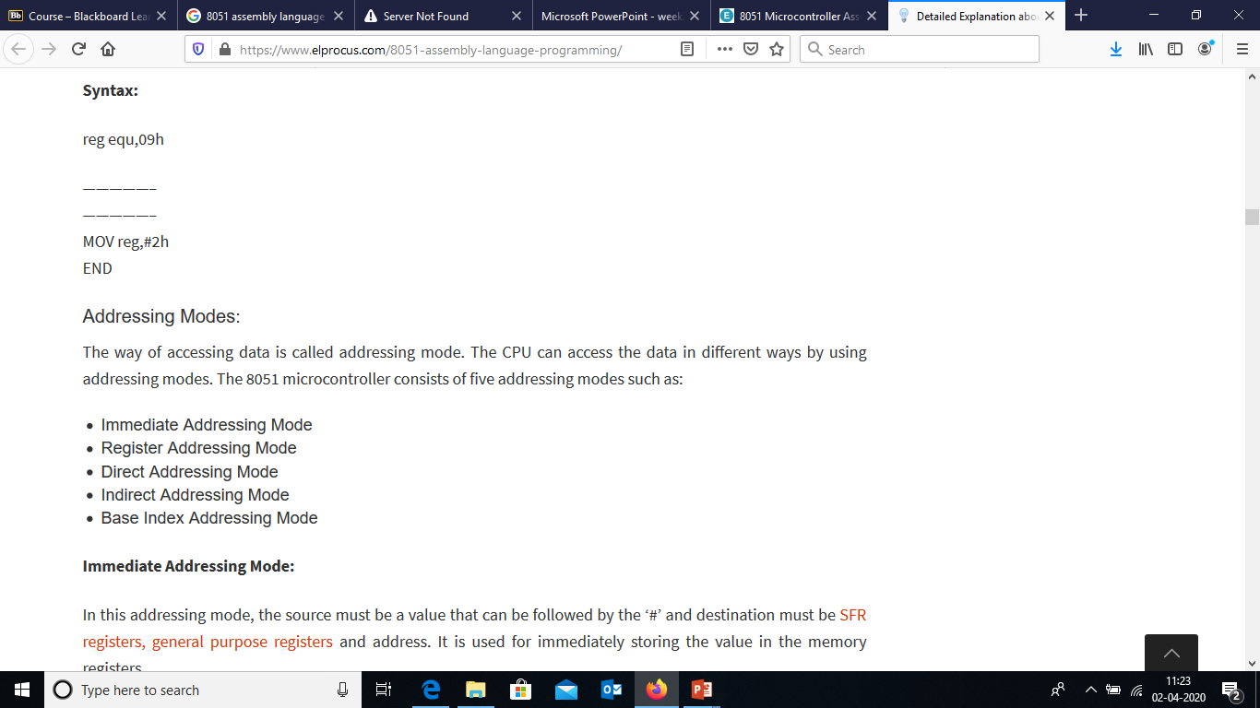

Slide 3
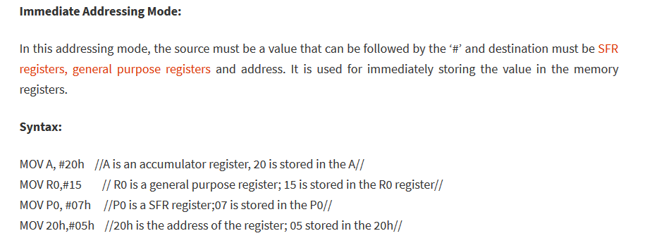

Slide 4


Slide 5
example
Immediate Mode – specify data by its value
mov A, #0 ;put 0 in the accumulator
;A = 00000000
mov R4, #11h ;put 11hex in the R4 register
;R4 = 00010001
mov B, #11 ;put 11 decimal in b register
;B = 00001011
mov DPTR,#7521h ;put 7521 hex in DPTR
;DPTR = 0111010100100001

Slide 6
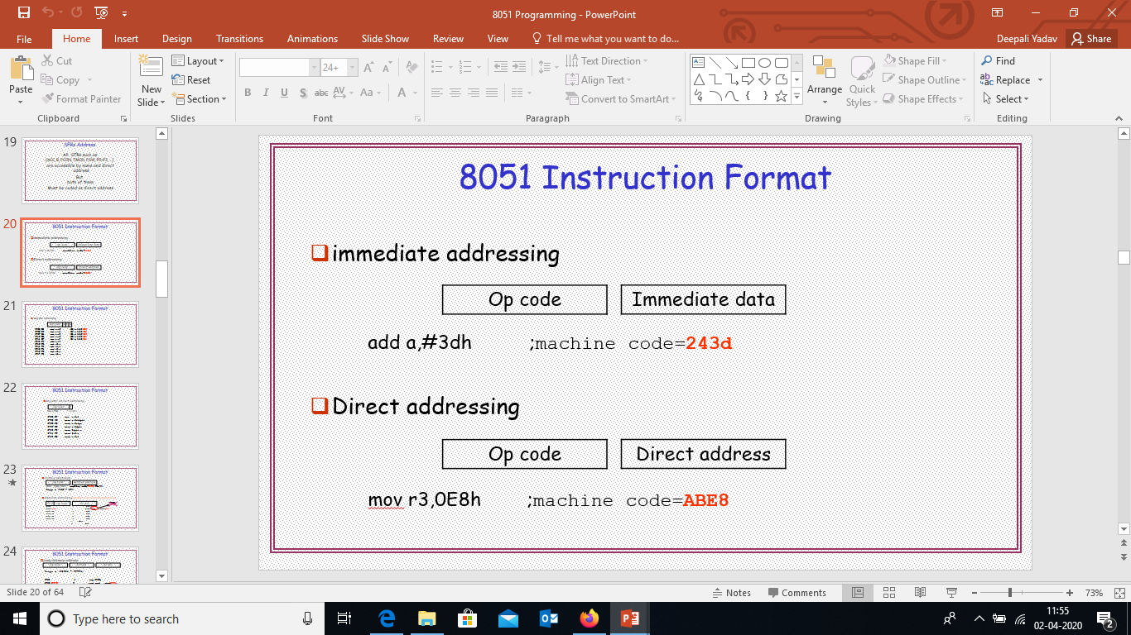
Instruction format

Slide 7
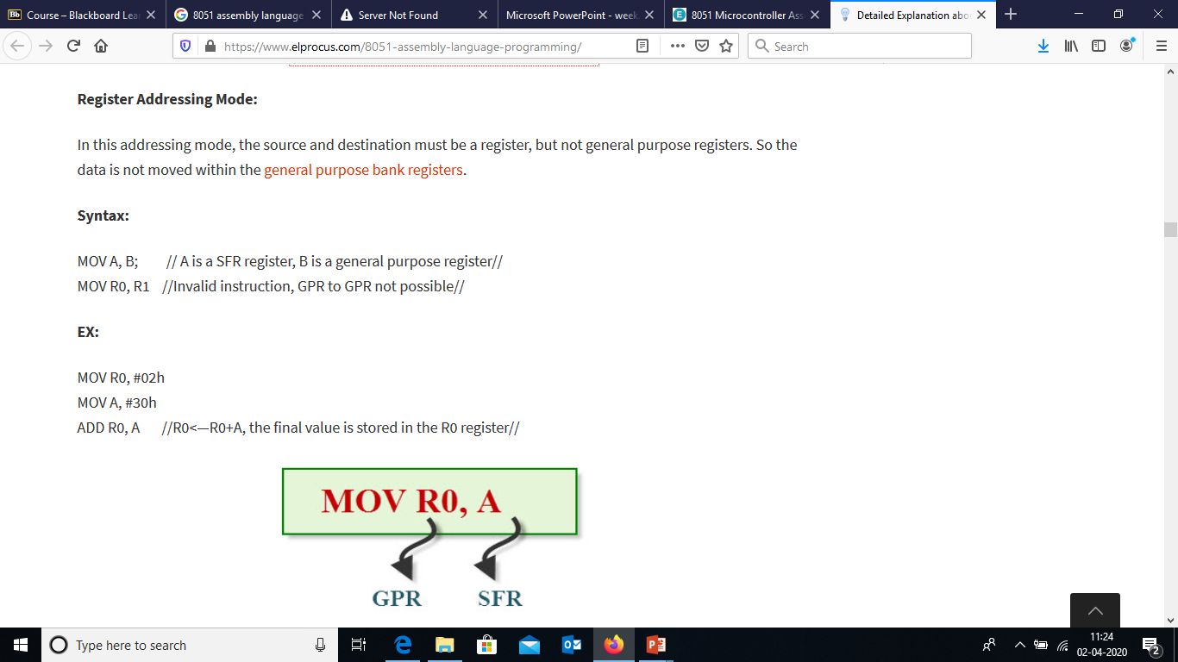

Slide 8
examples
Register Addressing – either source or destination is one of CPU register
MOV R0,A
MOV A,R7
ADD A,R4
ADD A,R7
MOV DPTR,#25F5H
MOV R5,DPL
MOV R,DPH
Note that MOV R4,R7 is incorrect

Slide 9
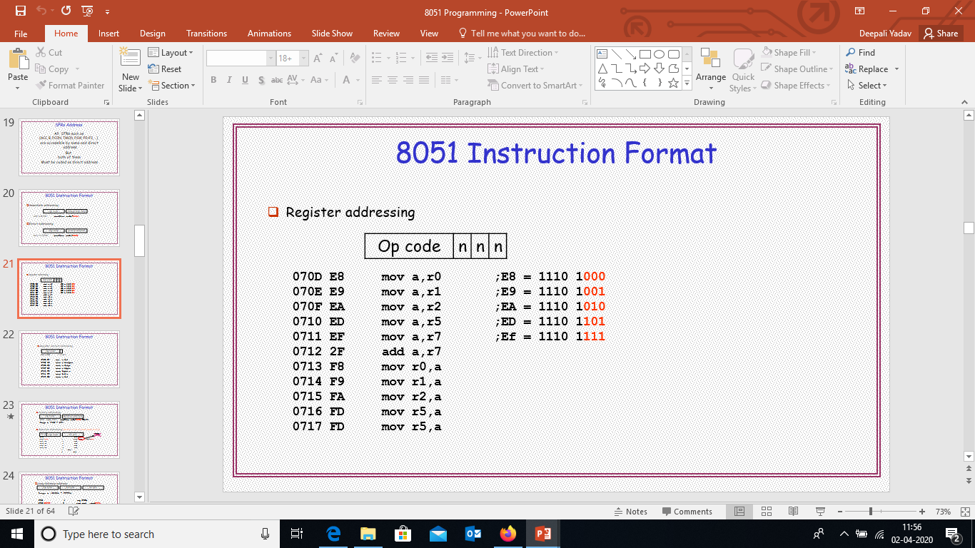
Instruction format

Slide 10
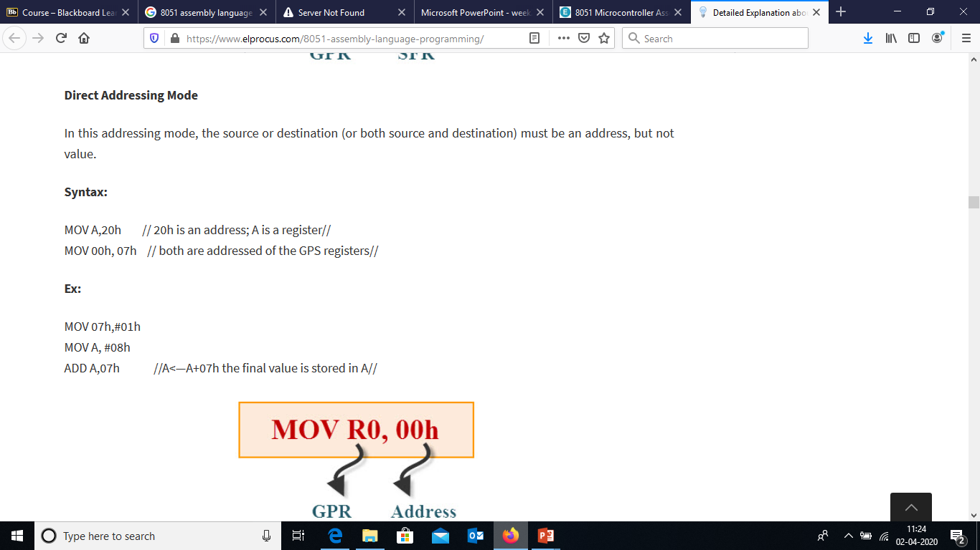

Slide 11
examples
Direct Mode – specify data by its 8-bit address (Usually for 30h-7Fh of RAM)
Mov a, 70h ; copy contents of RAM at 70h to a
Mov R0,40h ; copy contents of RAM at 40h to R0
Mov 56h,a ; put contents of a at 56h
Mov 0D0h,a ; put contents of a into PSW

Slide 12
examples
Direct Mode – with R0-R7 by direct address
MOV A,4 ≡ MOV A,R4
MOV A,7 ≡ MOV A,R7
MOV 7,2 ≡ MOV R7,R6
MOV R2,#5 ;Put 5 in R2

Slide 13
Instruction format

Slide 14
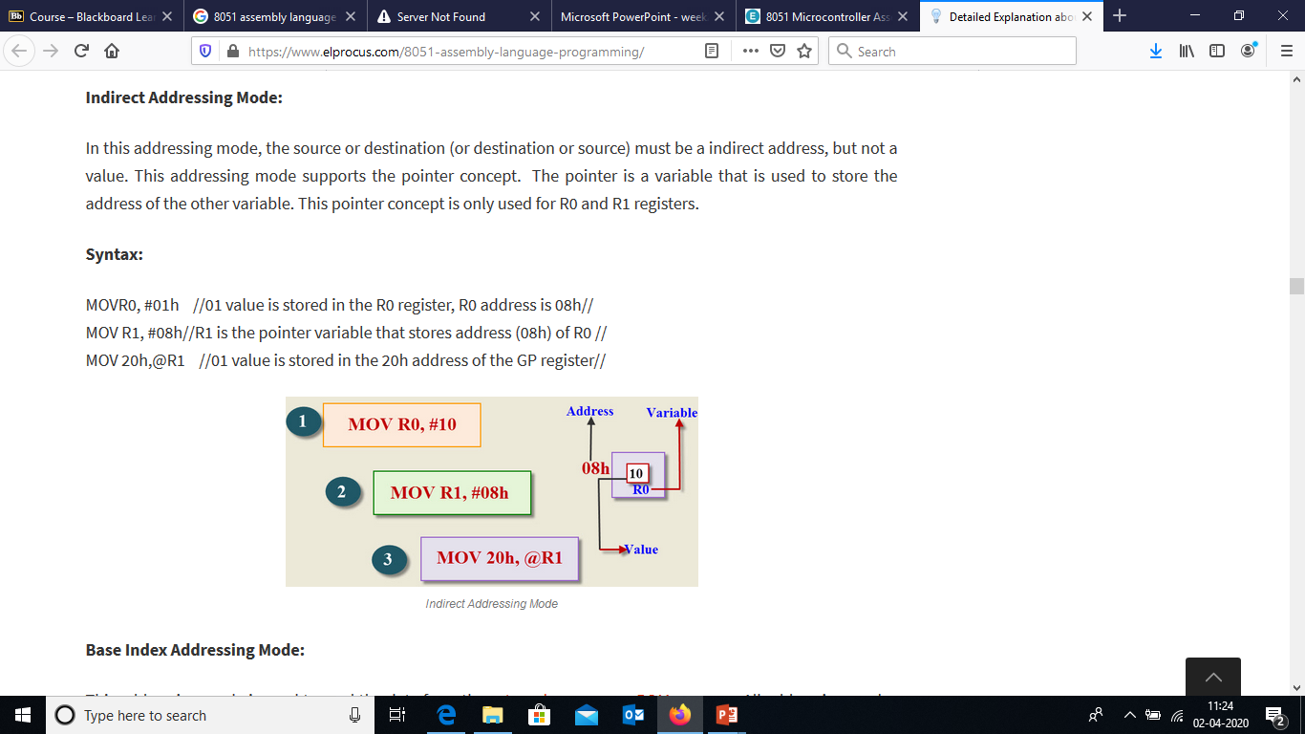

Slide 15
examples
Register Indirect – the address of the source or destination is specified in registers
Uses registers R0 or R1 for 8-bit address:
mov psw, #0 ; use register bank 0
mov r0, #3Ch
mov @r0, #3 ; memory at 3C gets #3
; M[3C] ← 3
Uses DPTR register for 16-bit addresses:
mov dptr, #9000h ; dptr ← 9000h
movx a, @dptr ; a ← M[9000]
Note that 9000 is an address in external memory

Slide 16
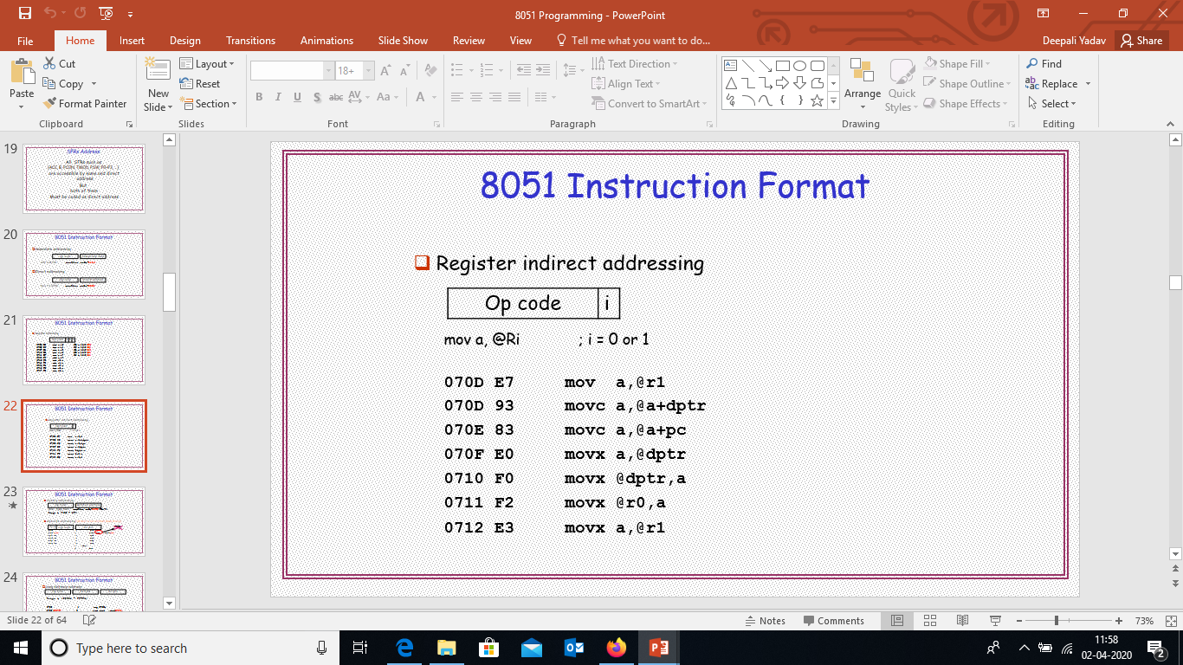
Instruction format

Slide 17
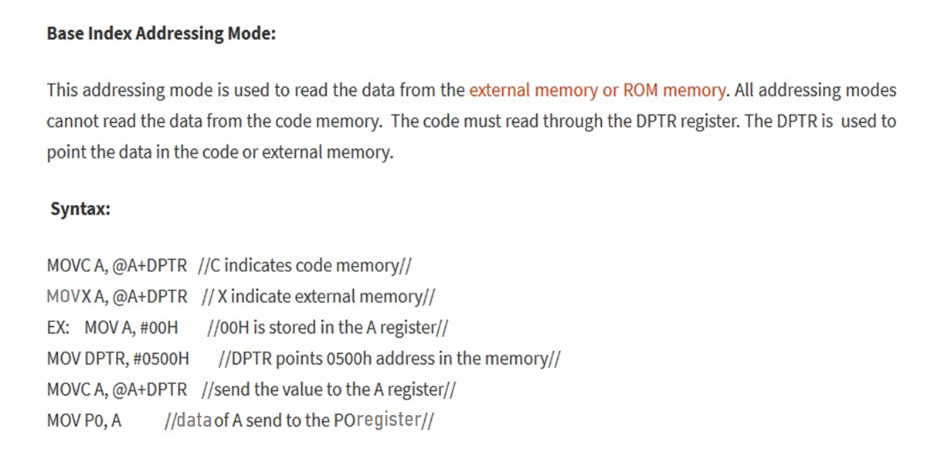

Slide 18
examples
Register Indexed Mode – source or destination address is the sum of the base address and the accumulator(Index)
Base address can be DPTR or PC
mov dptr, #4000h
mov a, #5
movc a, @a + dptr ;a ← M[4005]

Slide 19
Register Indexed Mode continue
Base address can be DPTR or PC
ORG 1000h
1000 mov a, #5
movc a, @a + PC ;a ← M[1008]
Nop
MOVC only can read internal code memory

Slide 20
8051 Programming

Slide 21
Programming Language
High Level Programming – Application Oriented such as C, C++, C#, Java etc
Low Level programming: Assembly Programming
In the early days of the computer, programmers coded in machine language, consisting of 0s and 1s
Tedious, slow and prone to error
Assembly languages, which provided mnemonics for the machine code instructions, plus other features, were developed
An Assembly language program consist of a series of lines of Assembly language instructions
Assembly language is referred to as a low level language
It deals directly with the internal structure of the CPU

Slide 22
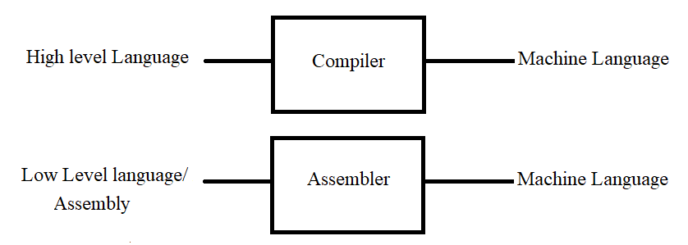
Compiler and Assembler
Compiler: Converts High level language program into machine level programming
Assembler: Converts low level language program into machine level programming

Slide 23
ASSEMBLER DIRECTIVES
The assembling directives give the directions to the CPU. The 8051 microcontroller consists of various kinds of assembly directives to give the direction to the control unit. The most useful directives are 8051 programming, such as:
ORG
DB
EQU
END

Slide 24
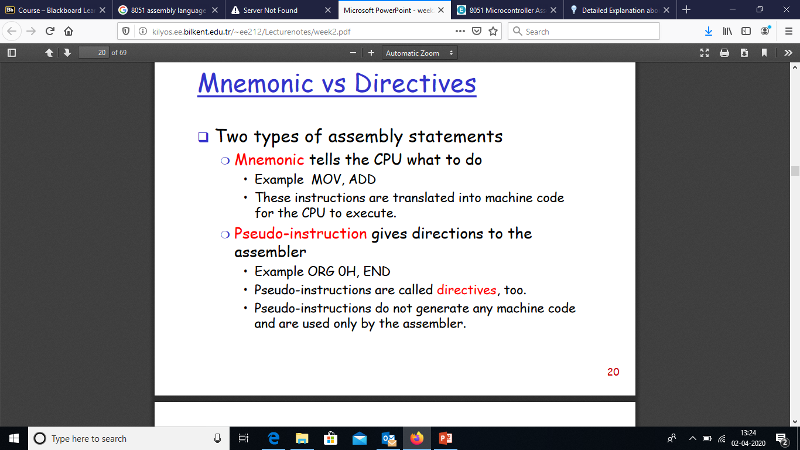

Slide 25
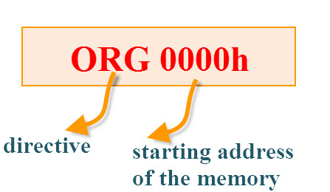
ORG(origin): This directive indicates the start of the program.
This is used to set the register address during assembly.
For example; ORG 0000h tells the compiler all subsequent code starting at address 0000h

Slide 26
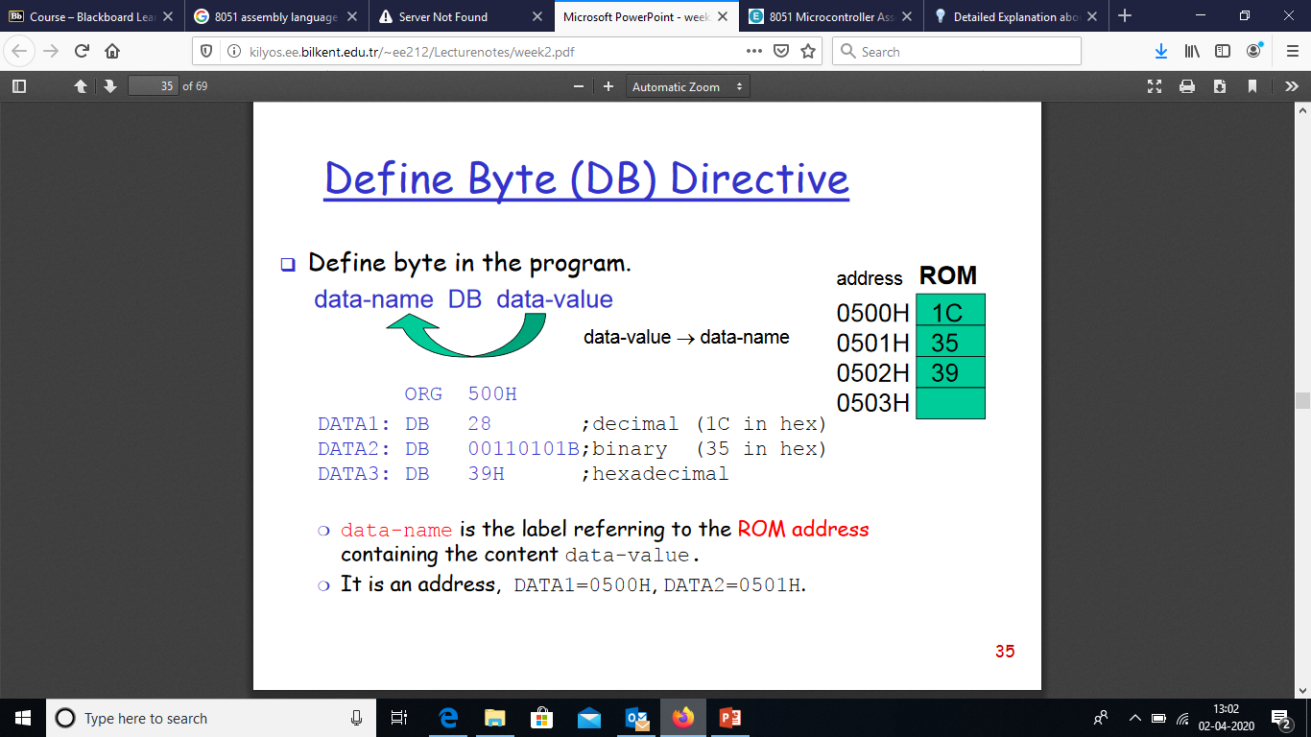

Slide 27
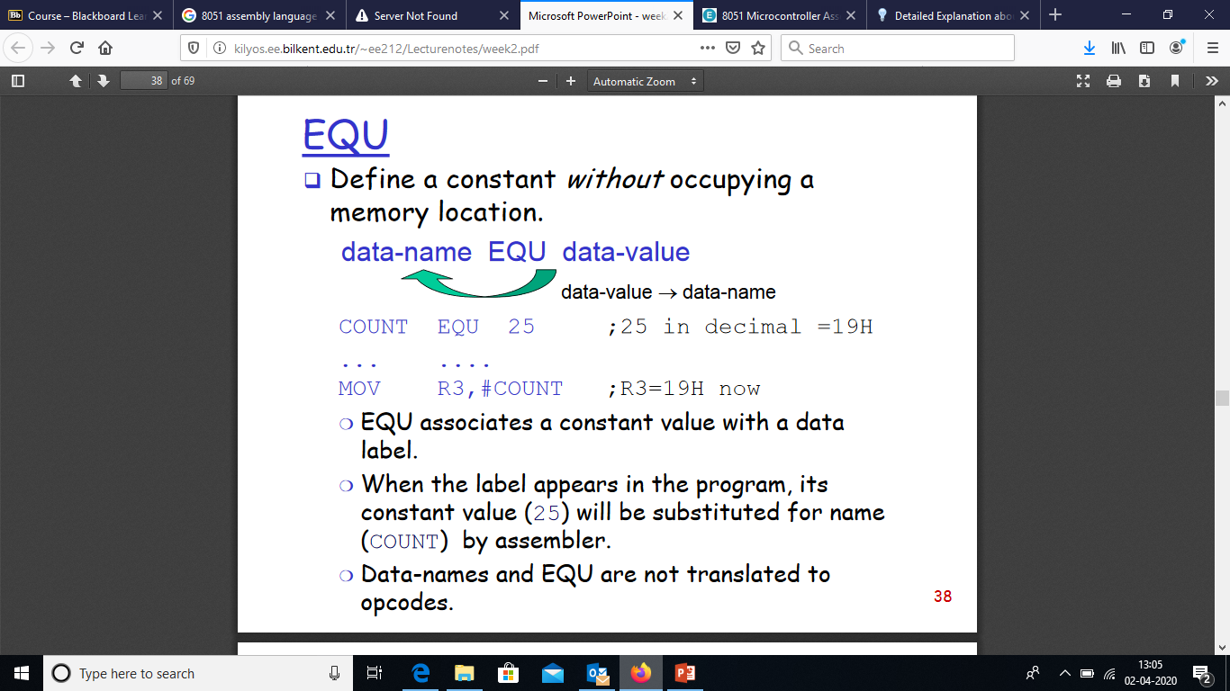

Slide 28
END:The END directive is used to indicate the end of the program.
Syntax:
reg equ,09h
—————– —————– MOV reg,#2h END

Slide 29
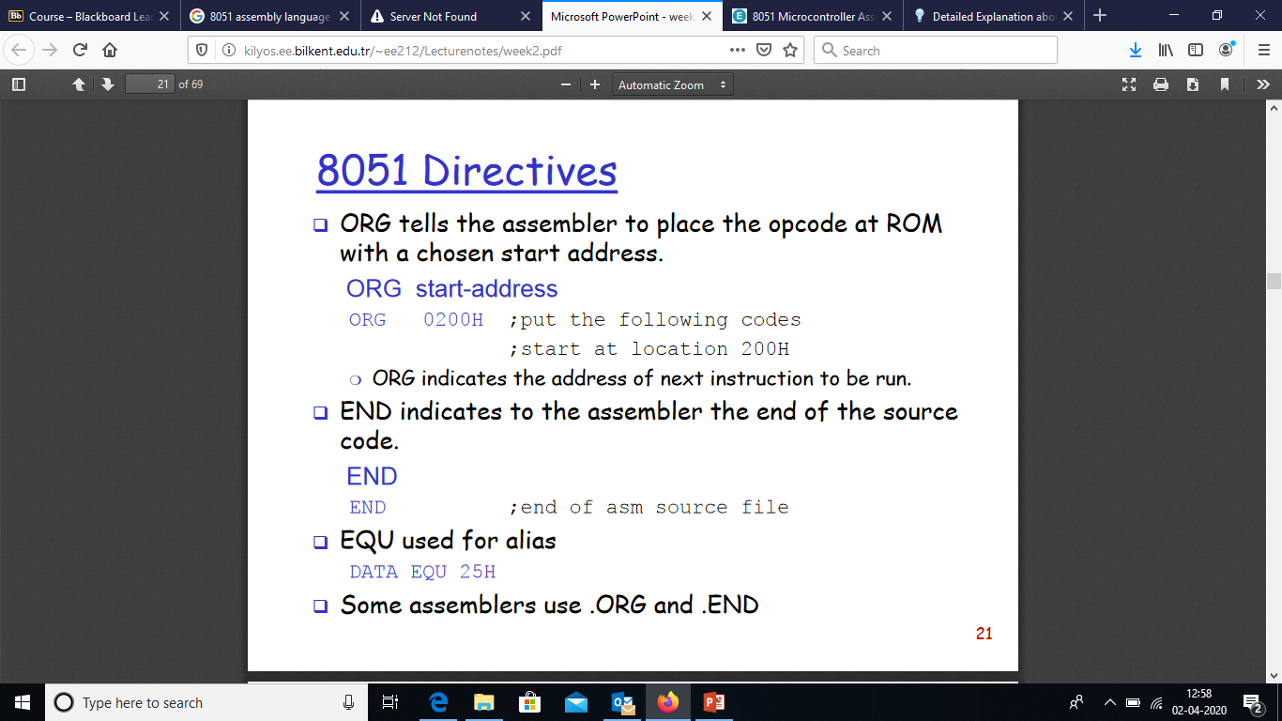

Slide 30
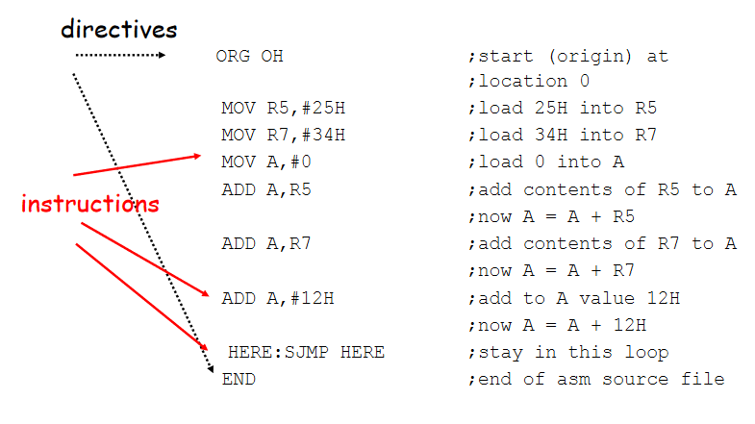

Slide 31
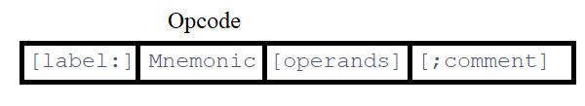
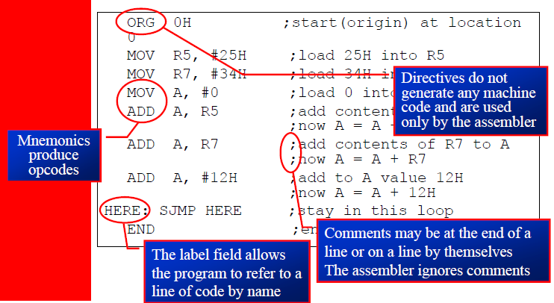
Assembly Programming Format
An Assembly language instruction consists of four fields:

Slide 32
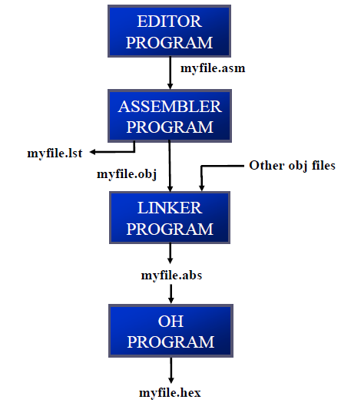
Flow to Run Code with Development Tools

Slide 33
The step of Assembly language are outlines as follows:
Editor: First we use an editor to type a program, many excellent editors or word processors are available that can be used to create and/or edit the program Notice that the editor must be able to produce an ASCII file
For many assemblers, the file names follow the usual DOS conventions, but the source file has the extension “asm“ or “src”, depending on which assembly you are using
Assembler: The “asm” source file containing the program code created in step 1 is fed to
an 8051 assembler :The assembler converts the instructions into machine code
The assembler will produce an object file and a list file
The extension for the object file is “obj” while the extension for the list file is “lst”

Slide 34
Linker and Loader : Assembler require a third step called linking
The linker program takes one or more object code files and produce an absolute object file with the extension “abs”
This abs file is used by 8051 trainers that have a monitor program
Object to Hex Converter (OH) : Next the “abs” file is fed into a program
called “OH” (object to hex converter) which creates a file with extension “hex” that is ready to burn into ROM
This program comes with all 8051 assemblers
Recent Windows-based assemblers combine step 2 through 4 into one step

Slide 35
Instructions
Data transfer instructions
Data processing (arithmetic and logic)
Program flow instructions

Slide 36
Data Transfer Instructions
MOV dest, source dest ← source
Stack instructions
PUSH byte ;increment stack pointer, ;move byte on stack
POP byte ;move from stack to byte, ;decrement stack pointer
Exchange instructions
XCH a, byte ;exchange accumulator and byte
XCHD a, byte ;exchange low nibbles of ;accumulator and byte

Slide 37
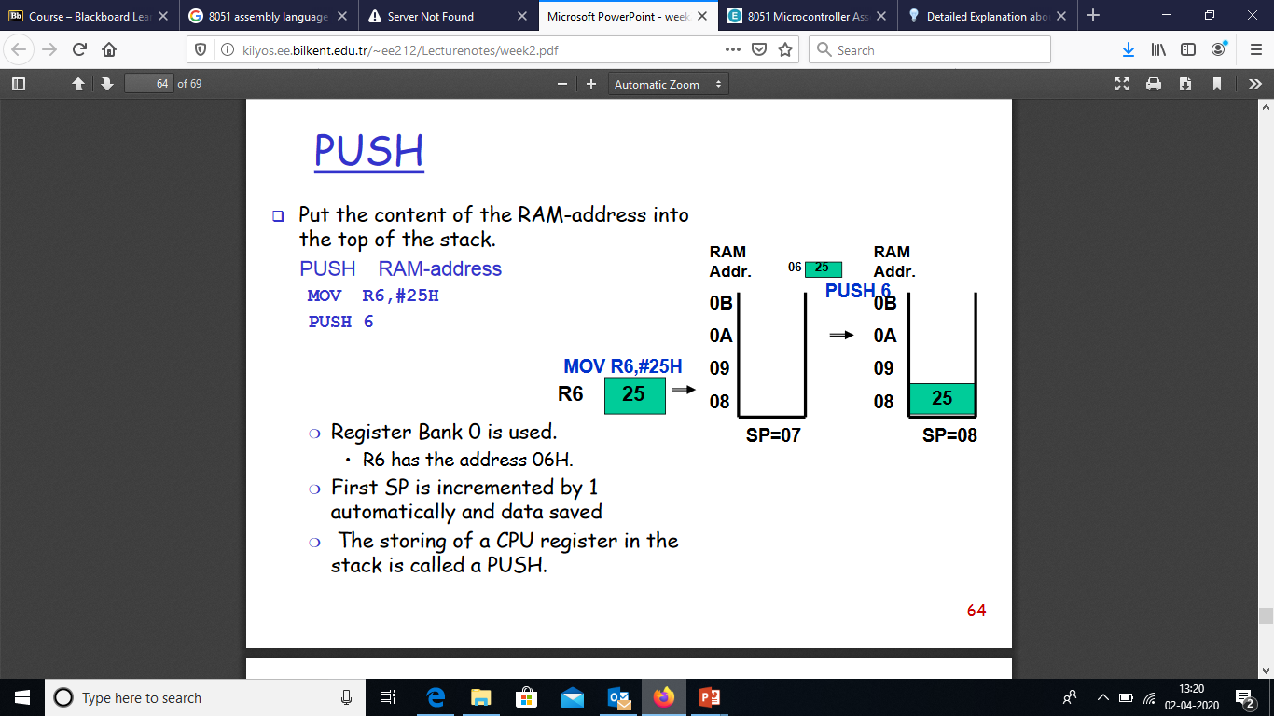

Slide 38
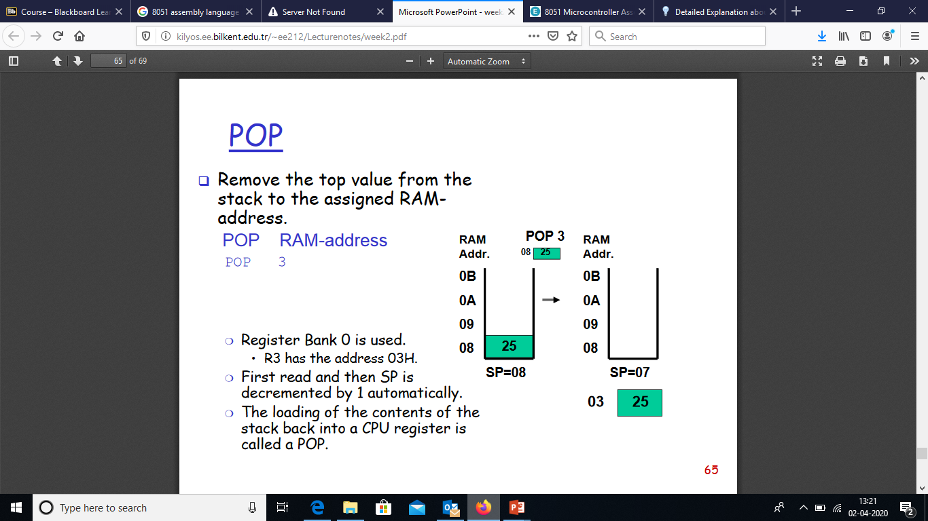

Slide 39
Exchange Instructions
two way data transfer
XCH a, 30h ; a ←→ M[30]
XCH a, R0 ; a ←→ R0
XCH a, @R0 ; a ←→ M[R0]
XCHD a, R0 ; exchange “digit”
a[7..4] a[3..0]
R0[7..4] R0[3..0]
Only 4 bits exchanged

Slide 40
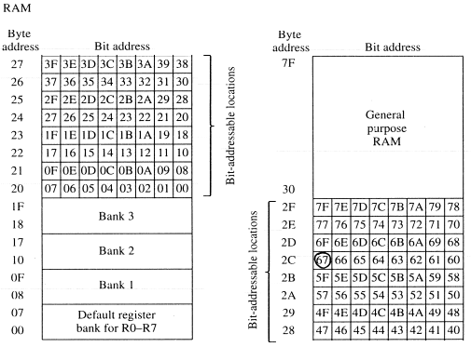
Bit-Oriented Data Transfer
transfers between individual bits.
Carry flag (C) (bit 7 in the PSW) is used as a single-bit accumulator
RAM bits in addresses 20-2F are bit addressable
mov C, P0.0
mov C, 67h

Slide 41
Data Processing Instructions
Arithmetic Instructions
Logic Instructions

Slide 42
Arithmetic Instructions
Add
Subtract
Increment
Decrement
Multiply
Divide
Decimal adjust

Slide 43
Arithmetic Instructions
Mnemonic | Description
ADD A, byte | add A to byte, put result in A
ADDC A, byte | add with carry
SUBB A, byte | subtract with borrow
INC A | increment A
INC byte | increment byte in memory
INC DPTR | increment data pointer
DEC A | decrement accumulator
DEC byte | decrement byte
MUL AB | multiply accumulator by b register
DIV AB | divide accumulator by b register
DA A | decimal adjust the accumulator

Slide 44
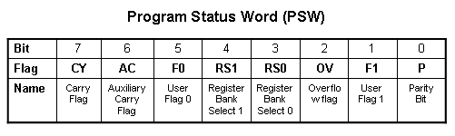
ADD Instructions
add a, byte ; a ← a + byte
addc a, byte ; a ← a + byte + C
These instructions affect 3 bits in PSW:
C = 1 if result of add is greater than FF
AC = 1 if there is a carry out of bit 3
OV = 1 if there is a carry out of bit 7, but not from bit 6, or visa versa.

Slide 45
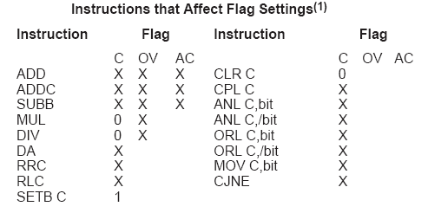
Instructions that Affect PSW bits

Slide 46
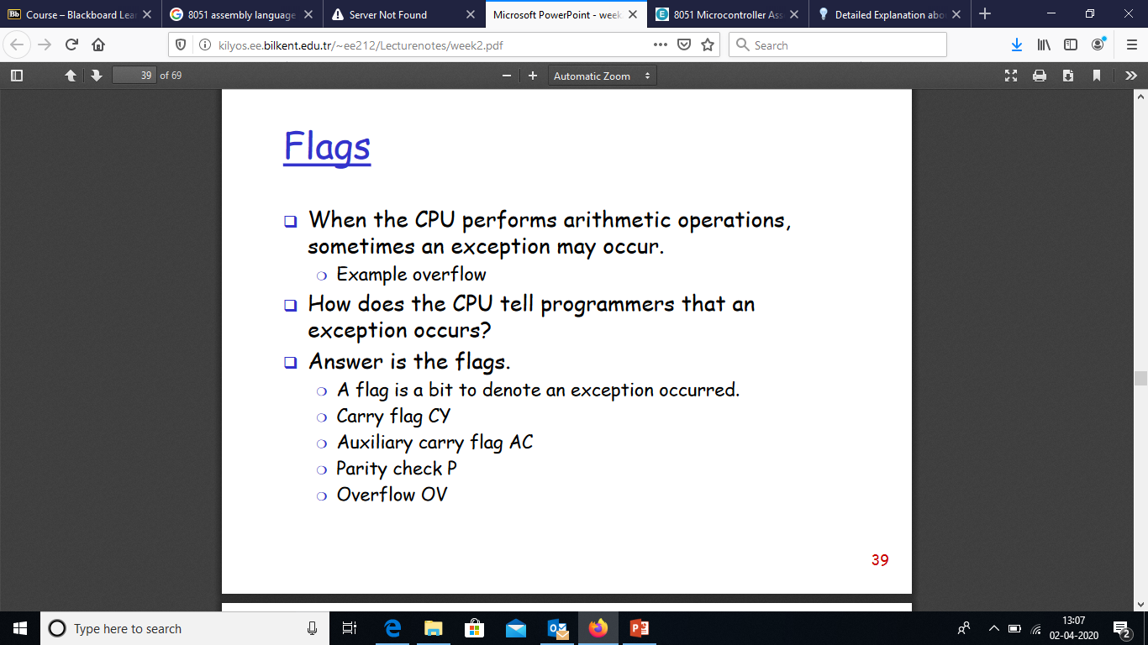

Slide 47
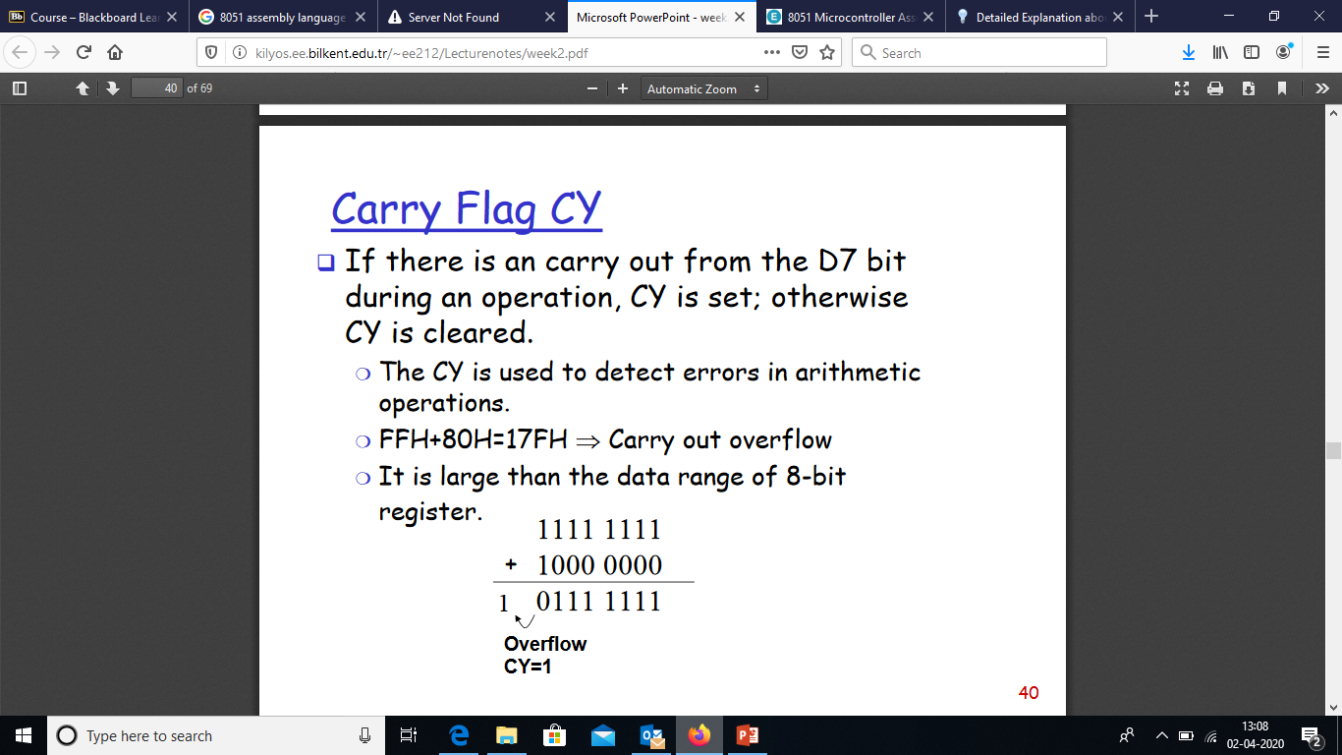

Slide 48
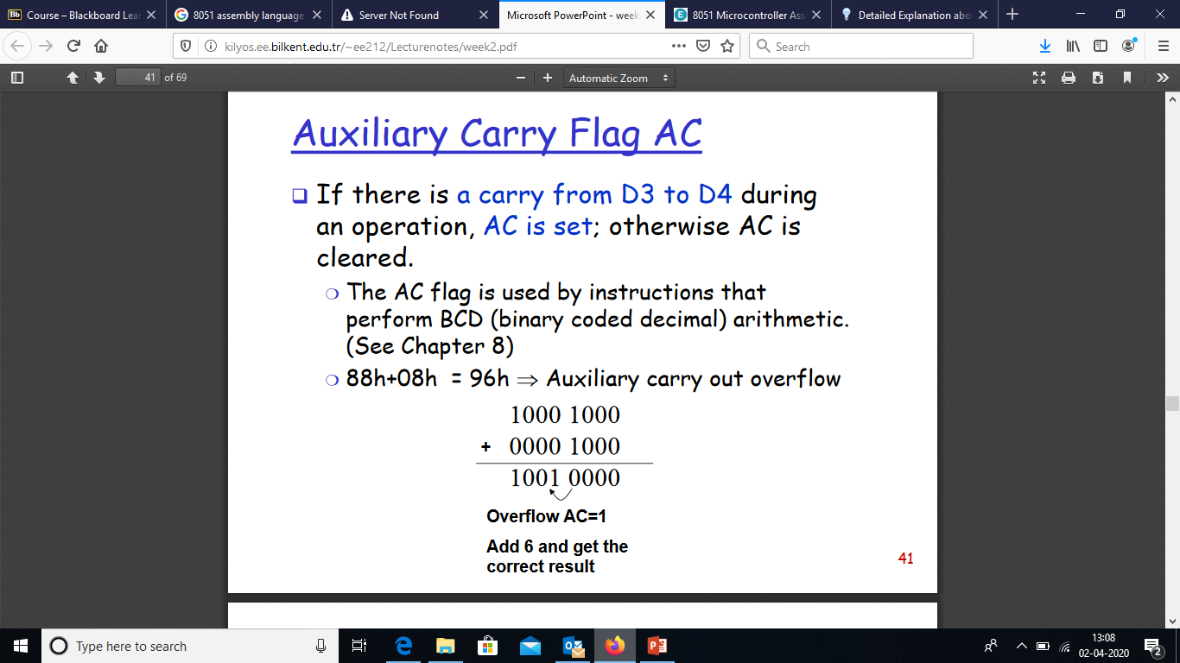

Slide 49
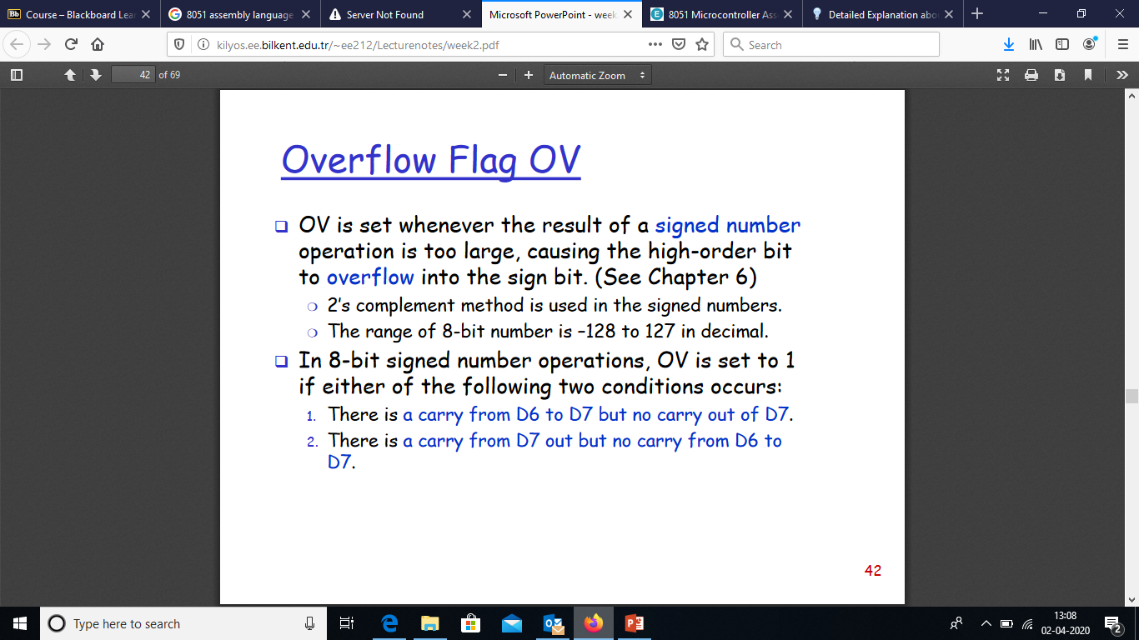

Slide 50
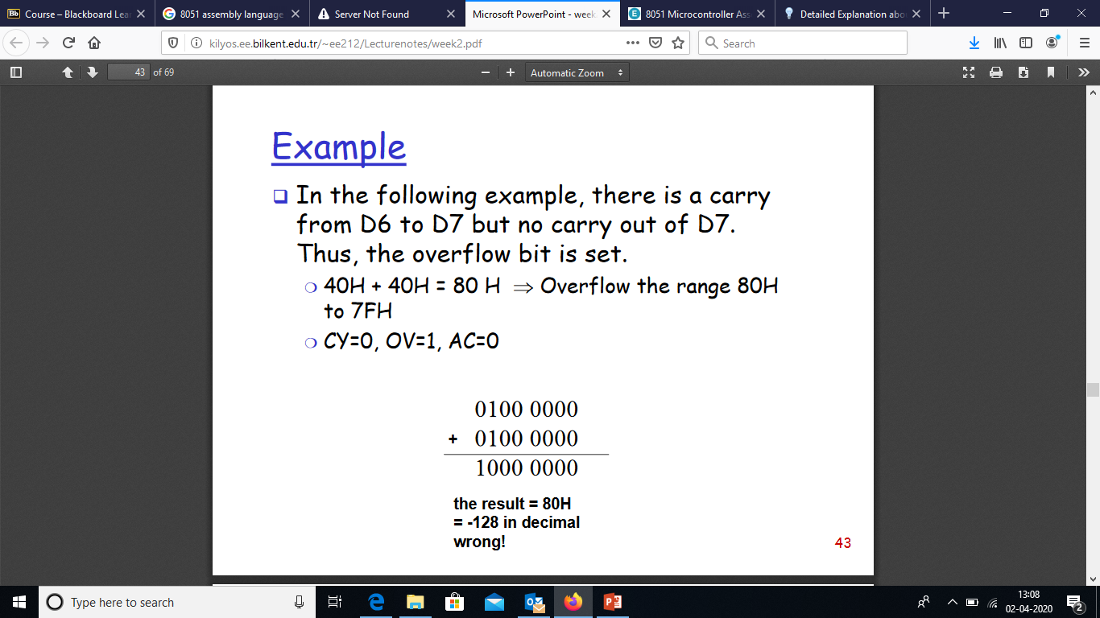

Slide 51
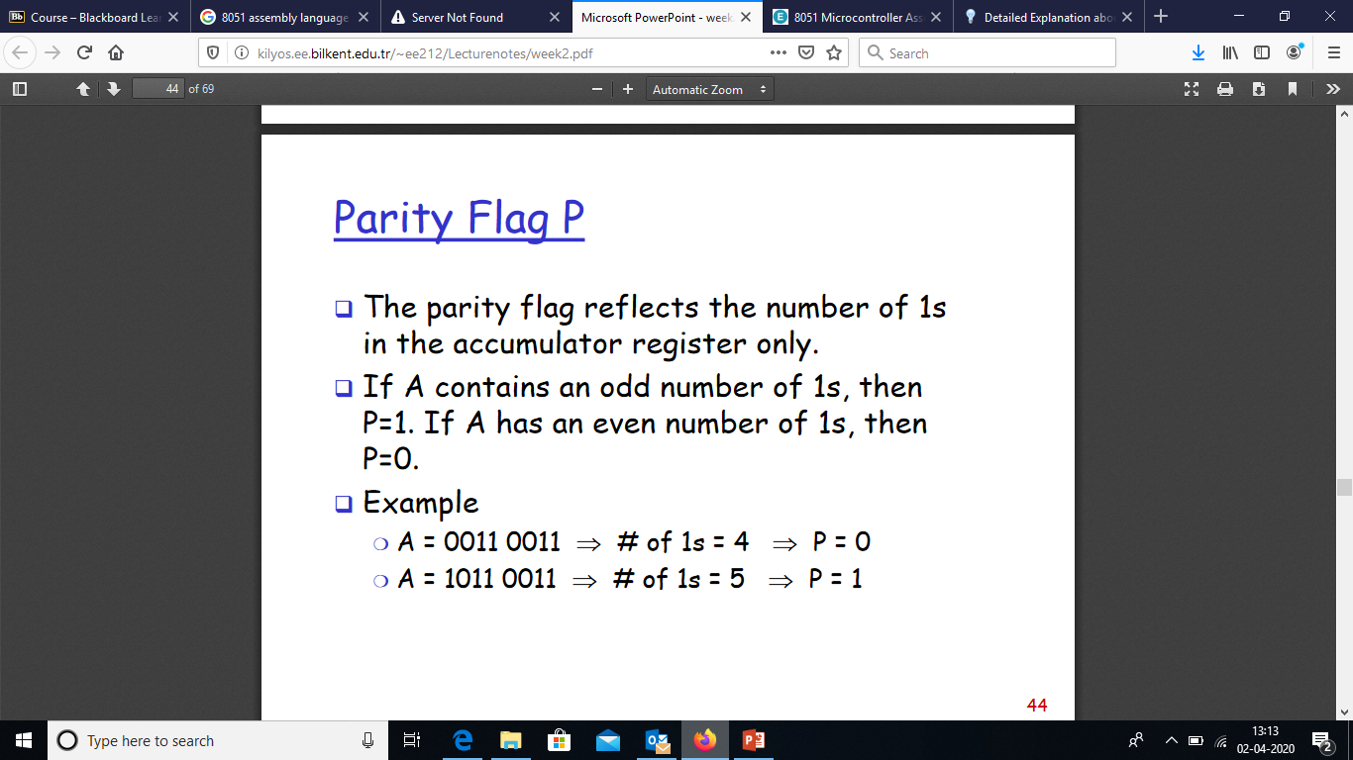

Slide 52
ADD Examples
mov a, #3Fh
add a, #D3h
What is the value of the C, AC, OV flags after the second instruction is executed?
0011 1111
1101 0011
0001 0010
C = 1
AC = 1
OV = 0

Slide 53
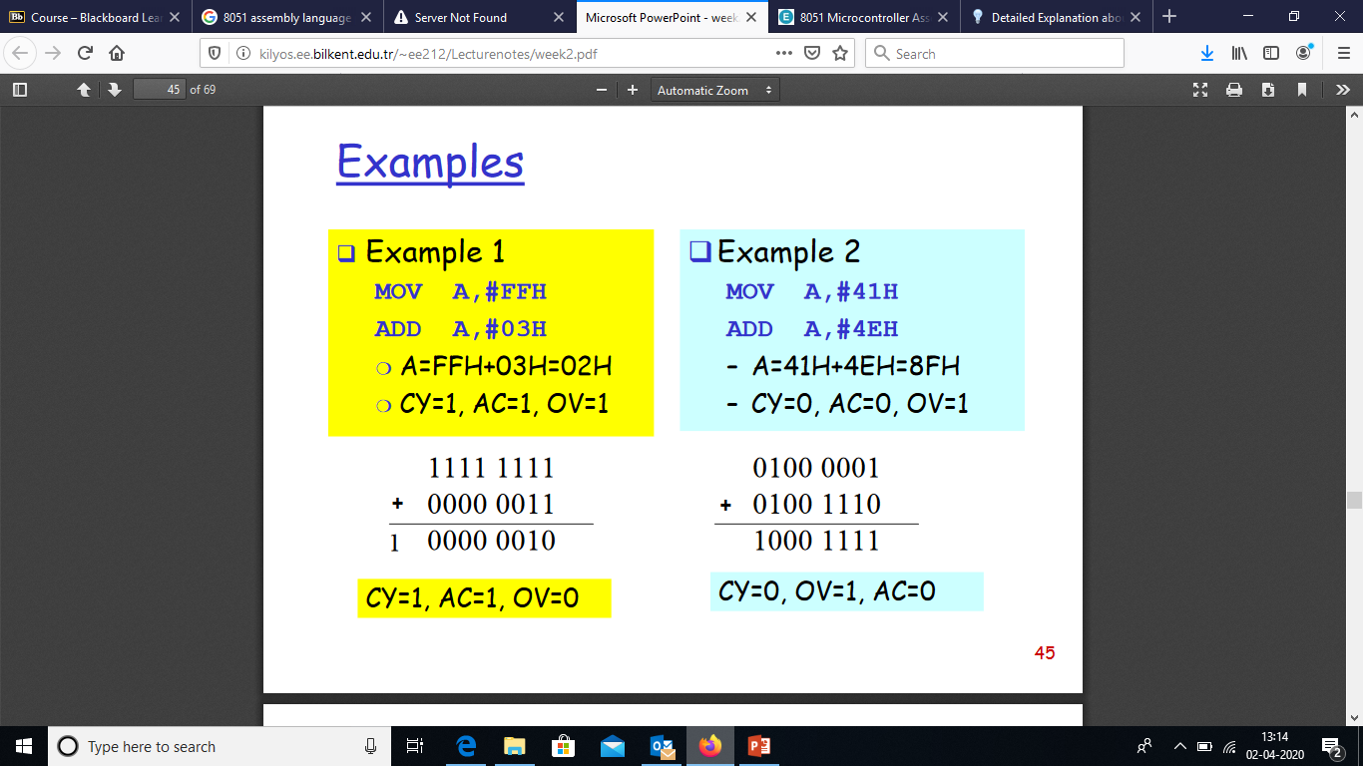

Slide 54
Subtract
SUBB A, byte | subtract with borrow
Example:
SUBB A, #0x4F ;A ← A – 4F – C
Notice that
There is no subtraction WITHOUT borrow.
Therefore, if a subtraction without borrow is desired,
it is necessary to clear the C flag.
Example:
Clr c
SUBB A, #0x4F ;A ← A – 4F

Slide 55
Increment and Decrement
INC A | increment A
INC byte | increment byte in memory
INC DPTR | increment data pointer
DEC A | decrement accumulator
DEC byte | decrement byte
The increment and decrement instructions do NOT affect the C flag.
Notice we can only INCREMENT the data pointer, not decrement.

Slide 56
Example: Increment 16-bit Word
Assume 16-bit word in R3:R2
mov a, r2
add a, #1 ; use add rather than increment to affect C
mov r2, a
mov a, r3
addc a, #0 ; add C to most significant byte
mov r3, a

Slide 57
Multiply
When multiplying two 8-bit numbers, the size of the maximum product is 16-bits
FF x FF = FE01
(255 x 255 = 65025)
MUL AB ; BA ← A * B
Note : B gets the High byte
A gets the Low byte

Slide 58
Division
Integer Division
DIV AB ; divide A by B
A ← Quotient(A/B)
B ← Remainder(A/B)
OV - used to indicate a divide by zero condition.
C – set to zero

Slide 59
Decimal Adjust
DA a ; decimal adjust a
Used to facilitate BCD addition.
Adds “6” to either high or low nibble after an addition
to create a valid BCD number.
Example:
mov a, #23h
mov b, #29h
add a, b ; a ← 23h + 29h = 4Ch (wanted 52)
DA a ; a ← a + 6 = 52

Slide 60
Logic Instructions
Bitwise logic operations
(AND, OR, XOR, NOT)
Clear
Rotate
Swap
Logic instructions do NOT affect the flags in PSW

Slide 61
Bitwise Logic
Examples:
ANL ➔ AND
ORL ➔ OR
XRL ➔ XOR
CPL ➔ Complement
00001111
10101100
ANL
00001100
00001111
10101100
ORL
10101111
00001111
10101100
XRL
10100011
CPL
10101100
01010011

Slide 62
Address Modes with Logic
ANL – AND
ORL – OR
XRL – eXclusive oR
CPL – Complement
a, byte
direct, reg. indirect, reg, immediate
byte, a
direct
byte, #constant
a ex: cpl a

Slide 63
Uses of Logic Instructions
Force individual bits low, without affecting other bits.
anl PSW, #0xE7 ;PSW AND 11100111
Force individual bits high.
orl PSW, #0x18 ;PSW OR 00011000
Complement individual bits
xrl P1, #0x40 ;P1 XRL 01000000

Slide 64
Other Logic Instructions
CLR - clear
RL – rotate left
RLC – rotate left through Carry
RR – rotate right
RRC – rotate right through Carry
SWAP – swap accumulator nibbles

Slide 65
CLR ( Set all bits to 0)
CLR A
CLR byte (direct mode)
CLR Ri (register mode)
CLR @Ri (register indirect mode)

Slide 66
Rotate
Rotate instructions operate only on a
RL a
Mov a,#0xF0 ; a← 11110000
RL a ; a← 11100001
RR a
Mov a,#0xF0 ; a← 11110000
RR a ; a← 01111000

Slide 67
Rotate through Carry
C
RRC a
mov a, #0A9h ; a ← A9
add a, #14h ; a ← BD (10111101), C←0
rrc a ; a ← 01011110, C←1
RLC a
mov a, #3ch ; a ← 3ch(00111100)
setb c ; c ← 1
rlc a ; a ← 01111001, C←1
C

Slide 68
Rotate and Multiplication/Division
Note that a shift/rotate left is the same as multiplying by 2, shift/rotate right is divide by 2
mov a, #3 ; A← 00000011 (3)
clr C ; C← 0
rlc a ; A← 00000110 (6)
rlc a ; A← 00001100 (12)
rrc a ; A← 00000110 (6)

Slide 69
Swap
SWAP a
mov a, #72h ; a ← 72h
swap a ; a ← 27h

Slide 70
Bit Logic Operations
Some logic operations can be used with single bit operands
ANL C, bit
ORL C, bit
CLR C
CLR bit
CPL C
CPL bit
SETB C
SETB bit
“bit” can be any of the bit-addressable RAM locations or SFRs.

Slide 71
Program Flow Control
Unconditional jumps (“go to”)
Conditional jumps
Call and return

Slide 72
Unconditional Jumps
SJMP <rel addr> ; Short jump, relative address is 8-bit 2’s complement number, so jump can be up to 127 locations forward, or 128 locations back.
LJMP <address 16> ; Long jump
AJMP <address 11> ; Absolute jump to anywhere within 2K block of program memory
JMP @A + DPTR ; Long indexed jump

Slide 73
Infinite Loops
Start: mov C, p3.7
mov p1.6, C
sjmp Start
Microcontroller application programs are almost always infinite loops!

Slide 74
Conditional Jump
These instructions cause a jump to occur only if a condition is true. Otherwise, program execution continues with the next instruction.
loop: mov a, P1
jz loop ; if a=0, goto loop, ; else goto next instruction
mov b, a
There is no zero flag (z)
Content of A checked for zero on time

Slide 75
Conditional jumps
Mnemonic | Description
JZ <rel addr> | Jump if a = 0
JNZ <rel addr> | Jump if a != 0
JC <rel addr> | Jump if C = 1
JNC <rel addr> | Jump if C != 1
JB <bit>, <rel addr> | Jump if bit = 1
JNB <bit>,<rel addr> | Jump if bit != 1
JBC <bir>, <rel addr> | Jump if bit =1, &clear bit
CJNE A, direct, <rel addr> | Compare A and memory, jump if not equal

Slide 76
Example: Conditional Jumps
if (a = 0) is true
send a 0 to LED
else
send a 1 to LED
jz led_off
Setb P1.6
sjmp skipover
led_off: clr P1.6
mov A, P0
skipover:

Slide 77
More Conditional Jumps
Mnemonic | Description
CJNE A, #data <rel addr> | Compare A and data, jump if not equal
CJNE Rn, #data <rel addr> | Compare Rn and data, jump if not equal
CJNE @Rn, #data <rel addr> | Compare Rn and memory, jump if not equal
DJNZ Rn, <rel addr> | Decrement Rn and then jump if not zero
DJNZ direct, <rel addr> | Decrement memory and then jump if not zero

Slide 78
Iterative Loops
For A = 0 to 4 do
{…}
clr a
loop: ...
...
inc a
cjne a, #4, loop
For A = 4 to 0 do
{…}
mov R0, #4
loop: ...
...
djnz R0, loop

Slide 79
Iterative Loops(examples)
mov a,#50h
mov b,#00h
cjne a,#50h,next
mov b,#01h
next: nop
end
mov a,#25h
mov r0,#10h
mov r2,#5
Again: mov @ro,a
inc r0
djnz r2,again
end
mov a,#0aah
mov b,#10h
Back1:mov r6,#50
Back2:cpl a
djnz r6,back2
djnz b,back1
end
mov a,#0h
mov r4,#12h
Back: add a,#05
djnz r4,back
mov r5,a
end

Slide 80
Call and Return
Call is similar to a jump, but
Call pushes PC on stack before branching
acall <address ll> ; stack ← PC
; PC ← address 11 bit
lcall <address 16> ; stack ← PC
; PC ← address 16 bit

Slide 81
Return
Return is also similar to a jump, but
Return instruction pops PC from stack to get address to jump to
ret ; PC ← stack

Slide 82
example of delay
mov a,#0aah
Back1:mov p0,a
lcall delay1
cpl a
sjmp back1
Delay1:mov r0,#0ffh;1cycle
Here: djnz r0,here ;2cycle
ret ;2cycle
end
Delay=1+255*2+2=513 cycle
Delay2:
mov r6,#0ffh
back1: mov r7,#0ffh ;1cycle
Here: djnz r7,here ;2cycle
djnz r6,back1;2cycle ret ;2cycle
end
Delay=1+(1+255*2+2)*255+2
=130818 machine cycle

Slide 83
Long delay Example
GREEN_LED: equ P1.6
org ooh
ljmp Main
org 100h
Main: clr GREEN_LED
Again: acall Delay
cpl GREEN_LED
sjmp Again
Delay: mov R7, #02
Loop1: mov R6, #00h
Loop0: mov R5, #00h
djnz R5, $
djnz R6, Loop0
djnz R7, Loop1
ret
END
reset service
main program
subroutine

